Slide 1
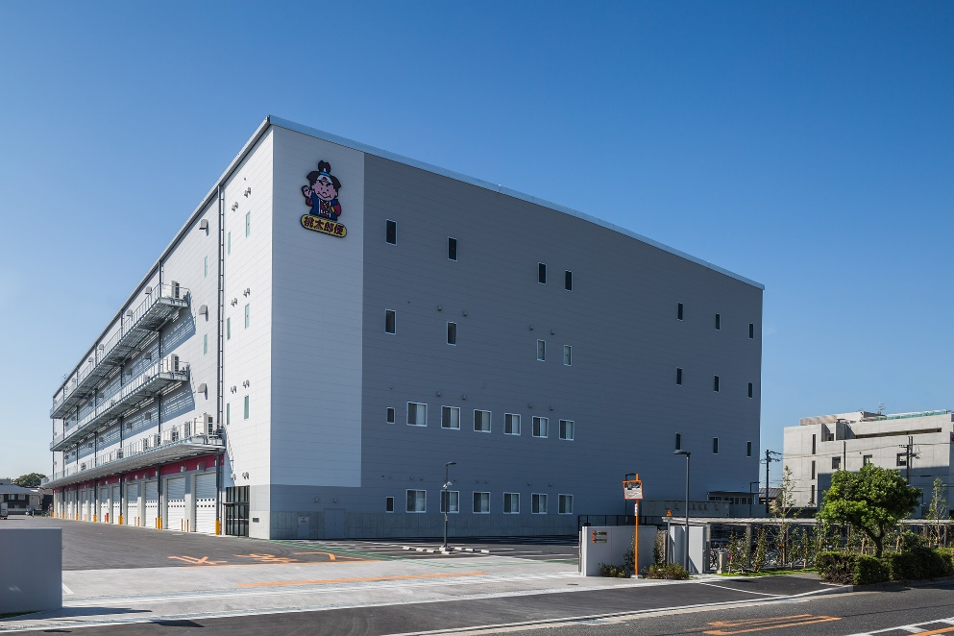
Outline of MK Osaka Center
(Matsumotokiyoshi Osaka Logistics Center)
MARUWA UNYU KIKAN Co., Ltd.
KANNSAI MARUWA LOGISTICS Co., Ltd.

Slide 2
Contents
１．Outline of MK Osaka Center
1.1． Logistics Network of MKHD
1.2． Background of Establishment
1.3． Concept of MK Osaka Center①
1.4． Concept of MK Osaka Center②
1.5． Delivery Area of MK Osaka Center
1.6． Location of MK Osaka Center
２. Functions and Operation Flow
2.1． Delivery Flow
2.2． Shipment Flow to Stores
2.3. Outline of Center Functions
2.4. Distribution Center Operation (Receiving Goods)
2.5. Distribution Center Operation (Inventory & Shipment)
2.6. Transfer Center (TypeⅠ＆ Type Ⅱ)
2.7. Transfer Center Operation(Receiving Goods)
2.8. Transfer Center Operation (Total Volume Sorting)
2.9. Shipment
2.10. Reverse Logistics (Total Volume Returns)
2.11. Omni-Channel (E-Commerce)
・・・ p.3
・・・ p.4
・・・ p.5
・・・ p.6
・・・ p.7
・・・ p.8
・・・ P.10
・・・ p.11
・・・ p.12
・・・ p.13
・・・ p.14
・・・ p.15
・・・ p.16
・・・ p.17
・・・ p.18
・・・ p.19
・・・ p.20

Slide 3
1. Outline of MK Osaka Center

Slide 4
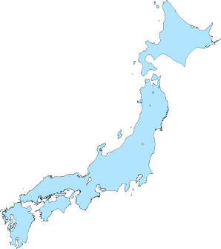
1.1．Logistics Network of MKHD
◆South Kanto Area
◆North Kanto Area
●MK Morioka Delivery Point
〒028-331
岩手県紫波郡紫波町犬渕字南谷地32-3
TEL：019-672-1000
FAX：019-672-1001
●MK Kanagawa Logistics Center
〒342-0008
神奈川県相模原市中央区田名3700-3
TEL：042-785-2680
FAX：042-785-2670
●MK Niigata Delivery Point
〒959-0501
新潟県新潟市西蒲区井随1758
TEL：0256-86-1008
FAX：0256-86-1006
●MK Nagano Delivery Point
〒381-2206
長野県長野市青木島町綱島780-19
TEL：026-286-5081
FAX：026-286-5091
◆West Japan Area
●MK Komaki Delivery Point
〒485-0082
愛知県小牧市村中1275-1
TEL：0568-54-2435
FAX：0568-54-2436
●MK Sendai Delivery Point
〒985-0833
宮城県多賀城市栄2-1-1 プロロジパーク多賀城
TEL：022-361-1170
FAX：022-361-1171
●MK Osaka Logistics Center
〒590-0904
大阪府堺市堺区南島町5丁162
TEL：072-224-1600
FAX：072-224-1601
●MK North Kanto Logistics Center
〒326-0005
栃木県足利市大月3-3
TEL：0284-40-1311
FAX：0284-40-1312
●MK Okayama Delivery Point
〒701-0221
岡山県岡山市南区藤田227-62
TEL：086-296-0035
FAX：086-296-0036
●MK Oyama Returns Center
〒342－0804
栃木県小山市萱橋1260－13
TEL 0285-39-1101
FAX 0285-49-3911
◆Kyushu Area
◆Kanto Area
●MK Kyushu Logistics Center
〒813-0023
福岡県福岡市東区蒲田3-9-70
TEL：092-663-6222
FAX：092-663-6223
●MK Noda Center
〒270-0239
千葉県野田市泉二丁目
TEL：04-7157-0745
FAX：04-7157-0746
6 Logistics Centers
8 Delivery Points
●MK Kagoshima Delivery Point
〒891-0115
鹿児島県鹿児島市東開町5-12
TEL：099-263-1130
FAX：099-263-1137
●MK Yoshikawa Logistics Center
〒342-0008
埼玉県吉川市旭7-1
TEL：048-993-2000
FAX：048-993-2220
＊ logistics centers
＊ delivery points
＊ returns center
-3-

Slide 5
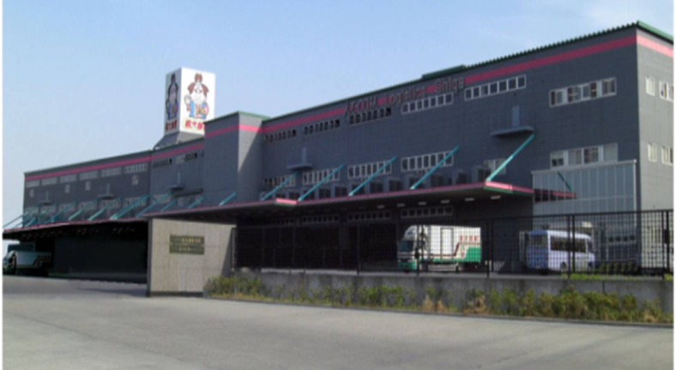

1.2．Background of Establishment
MK Shiga Center was established as the main logistics center of western Japan in April 2003. With increases in stores and shipment during the past 14 years, three delivery points (Okayama, Hokuriku, Komaki ) sequentially opened to provide efficient delivery and deal with increased inventory.
In Nov 2016, the center relocated from Shiga to Osaka in order to reconstruct strategic logistics networks and deal with Omni-channel, meanwhile to be closer to metropolitan areas.
【Each Floor 】
Shiga Center
Osaka Center
Floor
4F 3F | Distribution Center (Inventory and Shipment)
2F | Transfer Center (DAS)
 | Total Number Returns E Commerce
１F | Receiving goods(DC) Case Shipment (DC)
 | Receiving goods (TCⅠ)
 | Shipment of goods (TCⅠ) Receiving goods (TCⅡ）
 | Sorting by stores (TCⅡ）
 | Stores of MatsumotoKiyoshi
Location：滋賀県近江八幡市
Total Space Capacity：23,140
No. of Companies：16
No. of Stores：812
Total cost of goods passed：
4.3 billion yen/month
Total Piece of goods passed：
13 million pcs/month
Location：大阪府堺市堺区南島町
Total Space Capacity： 30,740㎡
No. of Companies：16
No. of Stores：1,000
Total cost of goods passed：
6 billion yen/month
Total Piece of goods passed：
20 million pcs/month
Capacity of Shipment
１５０％
Capacity of Inventory
１３０％

Slide 6
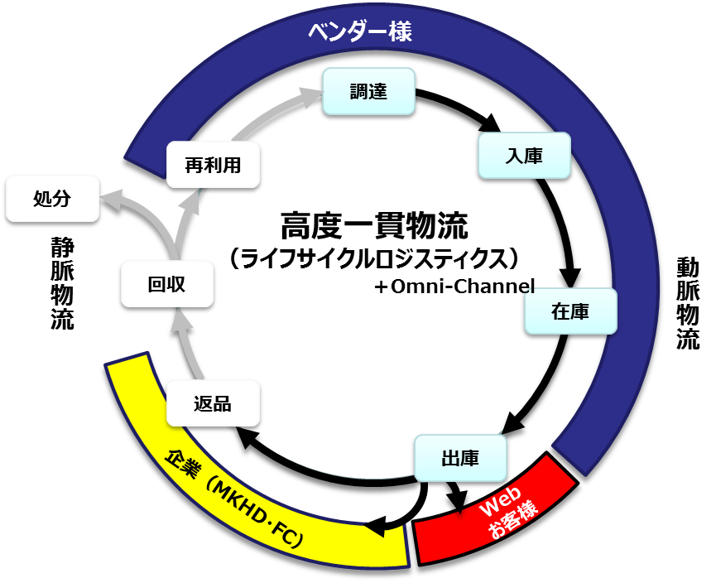
1.3．Concept of MK Osaka Center①
Evolution of Advanced Integrated Logistics
“Life Cycle Logistics”
・ “Life Cycle Logistics” of MK Kanagawa Center has further been evolved to
deal with both real stores and online stores.
・Advanced Integrated Logistics from receiving goods to disposal of returned goods
・MK Osaka Center not only has functions of usual physical distribution, but also
has functions of procurement and reverse logistics.
※LCL（Life Cycle Logistics) includes procurement,
arrival/ receipt of goods, inventory, shipment,
delivery to stores, returns, recycles, disposal and reuse.
・ “Life Cycle logistics”
① Usual Physical Distribution: deliver goods to stores.
・Total management from physical procurement to inventory,
shipment, delivery to stores.
・Evolution of delivering goods classified by categories
(combined shipping of DC/TC goods).
②Reverse logistics: collect and assort returned goods.
・Reduction of store burden by total quantity returns.

Slide 7
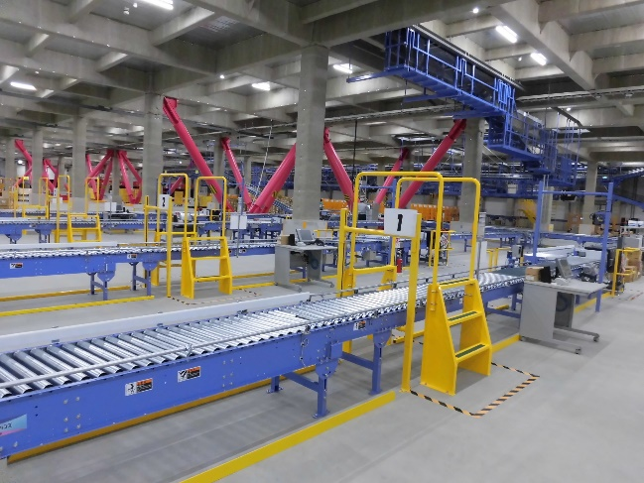
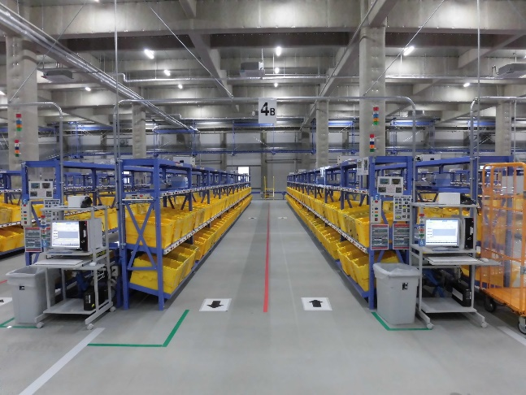
1.4．Concept of MK Osaka Center②
【Center Designed for MK Exclusive Use】
MK Osaka Center has been designed for efficient operation.
For example, there are no walls inside building so material handling
equipments can be installed as desired.
【Custom-made System】
Combining systems installed at other MK centers, new system
has been customized to the characteristics of MK Osaka Center.
In addition, new devices have been introduced to improve efficiency, such as sorters for receiving goods, multi-tiered picking cart, etc.
When designing system, many meetings had been held with system vender to determine specifications in details to construct system suitable for field operation.

Slide 8
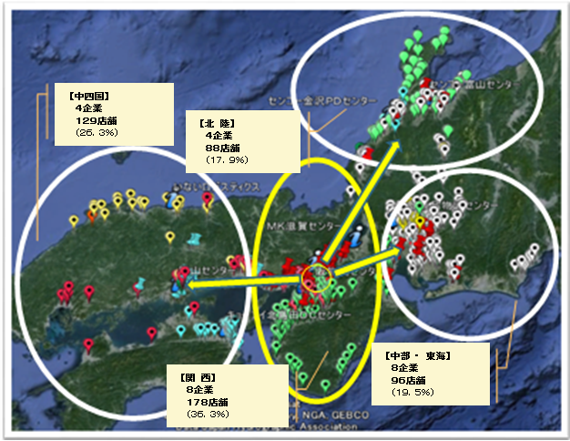
1.5．Delivery Area of MK Osaka Center
・Delivery to 491 stores in 4 areas in Western Japan.
・Clients：Matsumotokiyoshi Holdings and its franchise stores.
②【Chushikoku
area】
4 companies
129 stores
(26.3%)
④【Hokuriku area】
3 companies
88 stores
(17.9%)
③【Tokai area】
7 companies
96 stores
(19.5%)
③【Kansai area】
8 companies
178 stores
(36.6%)
①Kansai area（yellow circle）：delivery to stores directly from MK Osaka Center.
②～④ Other areas（white circle）：delivery to stores from Delivery Points.

Slide 9
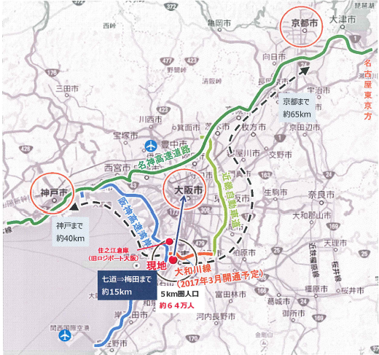
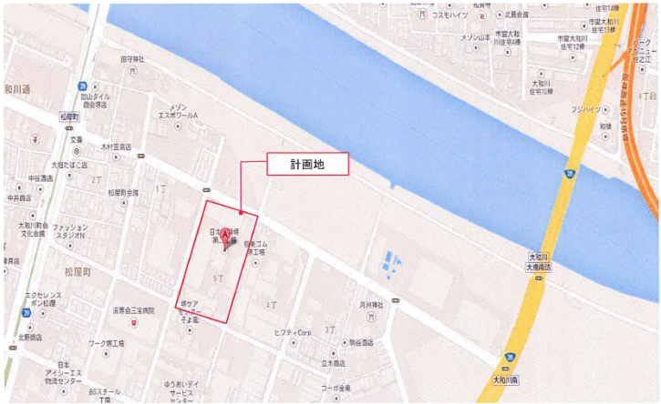
1.6．Location of MK Osaka Center
・Located near the large consumption areas of Osaka, 15km to Umeda Station.
・640 thousand residents within a radius of 5km of MK Osaka Center.
Location：Minamishimachou 5-162, Sakaiku, Sakaishi, Osaka prefecture
所在地
Distance to roads:
North 12m・East 5m・South 8m・West 6m

Slide 10
2. Functions & Operation Flow

Slide 11
2.1. Delivery Flow
Stores
MKHD（SCSK）
vendors
Purchase
Order
(P/O)
P/O
MK Osaka Center
Delivery of Goods
P/O
FAX (P/O)
Shipping
Records
ASN
Data center
P/O
ASN
＊Inspection/Sorting
Shipping
Records
Shipping
Records
：Business Scope of
Logistics Center
Delivery of Goods
①Stores place P/O(purchase order) to Venders via MKHD（SCSK）
②Venders deliver goods to MK Osaka Center according to P/O.
③Goods received are inspected and sorted at MK Osaka Center, then delivered to stores.
④Shipping records are transmitted to MKHD(SCSK).

Slide 12
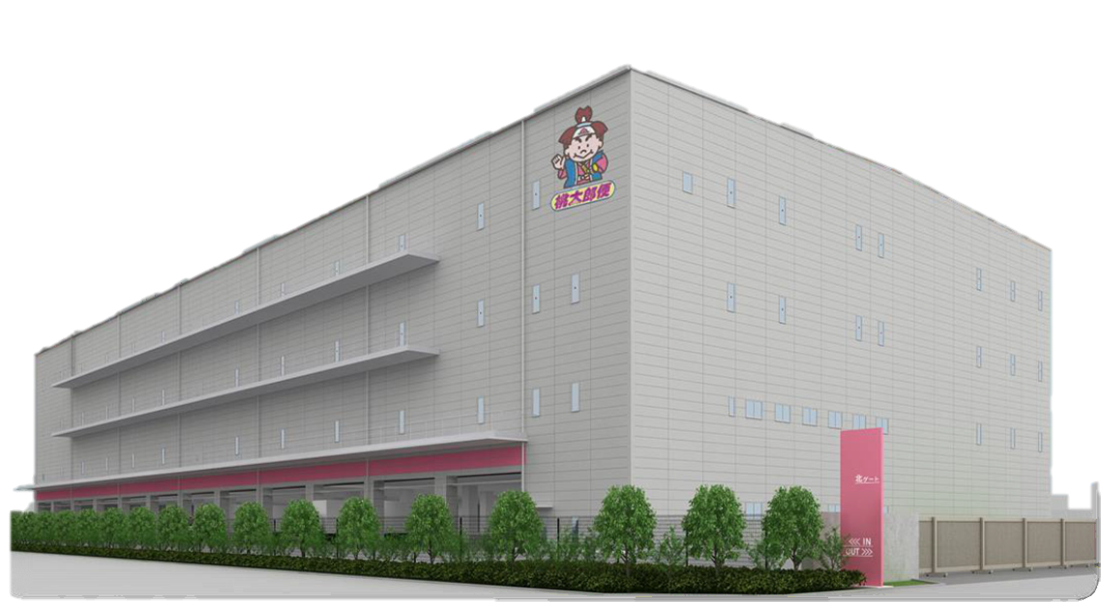






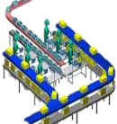
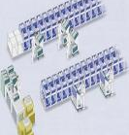
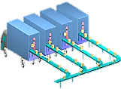
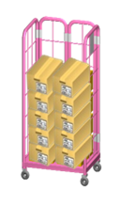
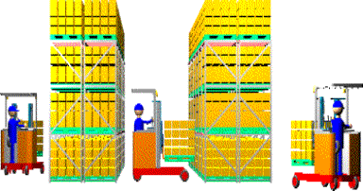
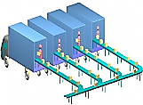
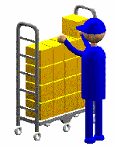
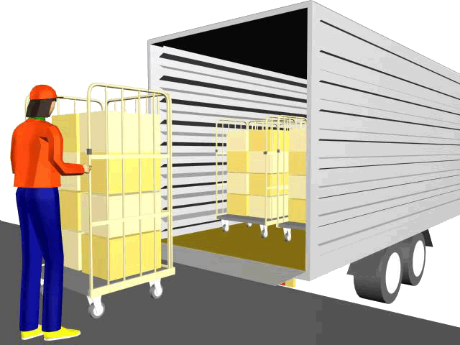
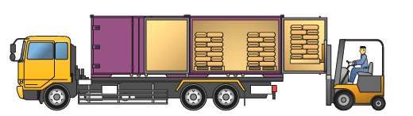
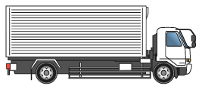
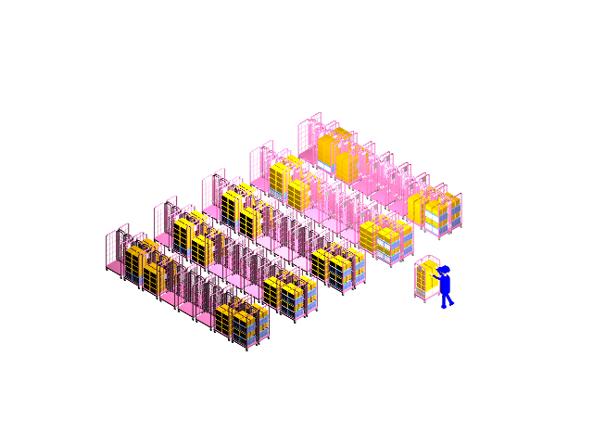
2.2．Shipment Flow to Stores (at Center)
Vendors
MK Osaka Center（MARUWA UNYU KIKAN）
Stores
Receiving Goods
Shipment
Assorting
ＴＣ( TypeⅠ)
Content Inspection
By Areas/ Stores
Transfer Center
（Delivery by Stores）
No. of Package
Inspection
Areas
① Primary Inspection
②Assorting by Stores（DAS）
・Kansai
・Chubu,Tokai
・Chushikoku
・Hokuriku
Total
14 companies
500 stores
ＴＣ( TypeⅡ)
Delivery
Transfer Center
（Total Quantity Delivery）
Delivery
Loading
Inspection
Join DAS
Receiving
Inspection
①Put Away
③-1 Total Picking
ＤＣ
Distribution Center
②Shelf Replenishment
③-2 Picking by Stores

Slide 13
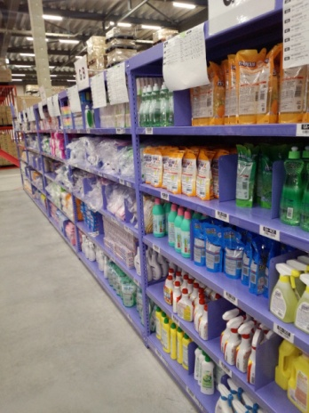
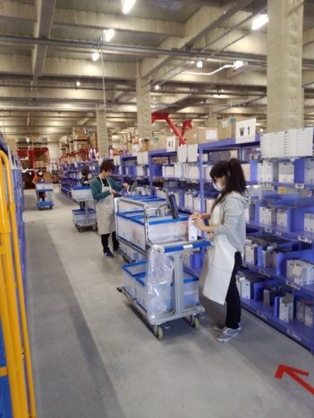
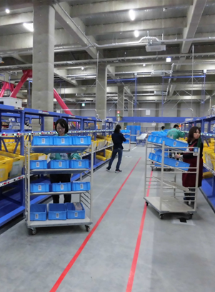
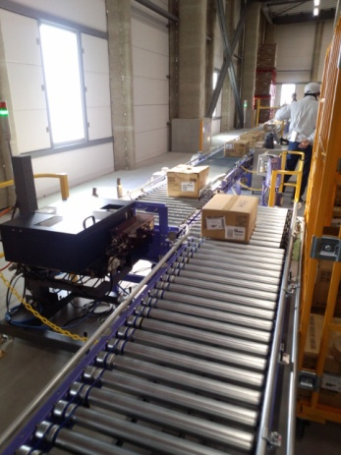
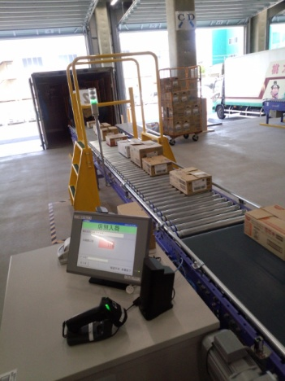
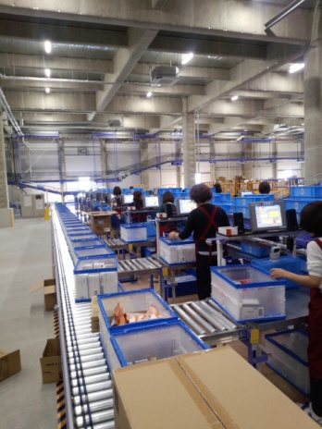
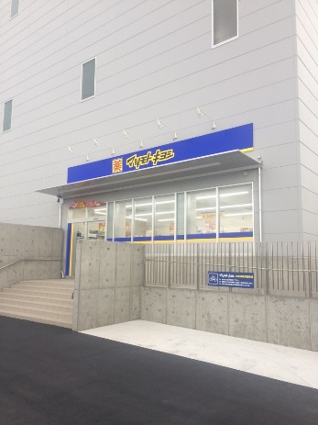
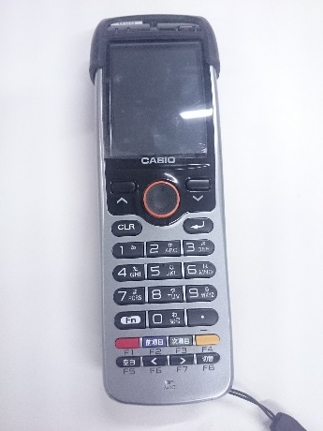
2.3. Outline of Center Functions
・MK Osaka Center consolidates picking by categories & stores with total picking & sorting to correspond flexibly to shipment to various companies.
Inventory Area | Multi-Tiers Picking Cart | Digital Assort System(DAS) | Auto-Labeler
HHT (Hand Held Terminal) | Sorting Goods Recieved | Primary Inspection of TCⅡ | Store of EC

Slide 14
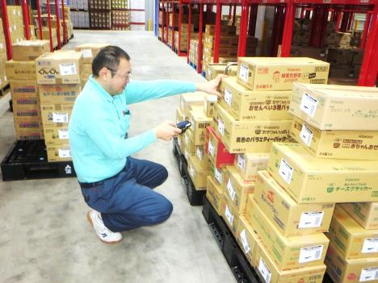
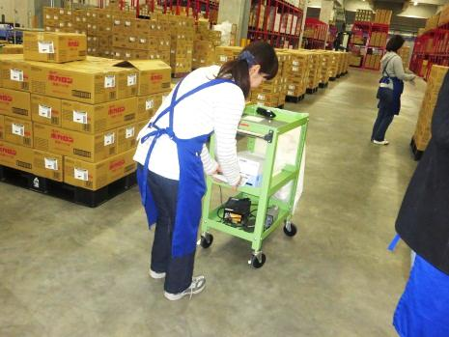
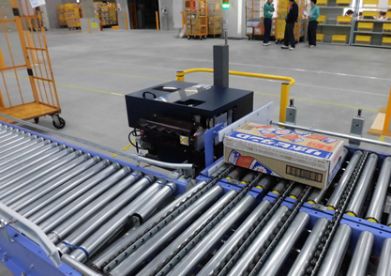
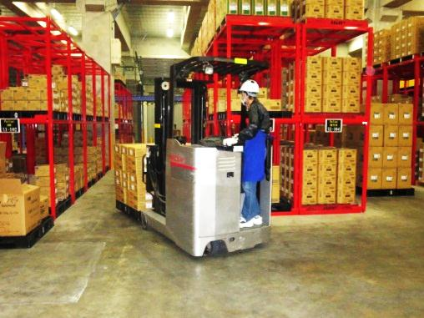
2.4. Distribution Center(Receiving Goods)
・Receiving goods from vendors and keeping in stock.
・At MK Osaka Center, new sorters and auto-labelers have been introduced
in addition to HHTs(Hand Held Terminal).
・Goods and locations are managed via WMS (Warehouse Management System) .

Slide 15
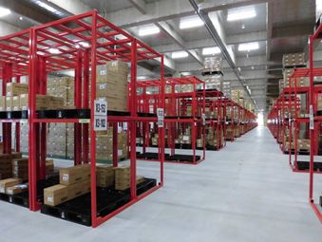
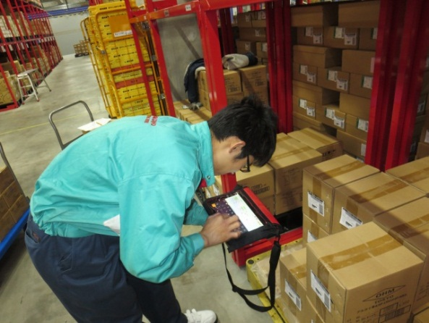
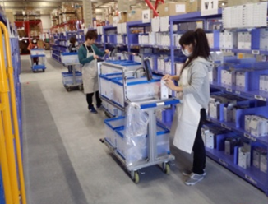
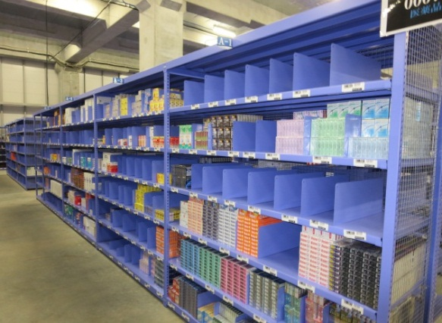
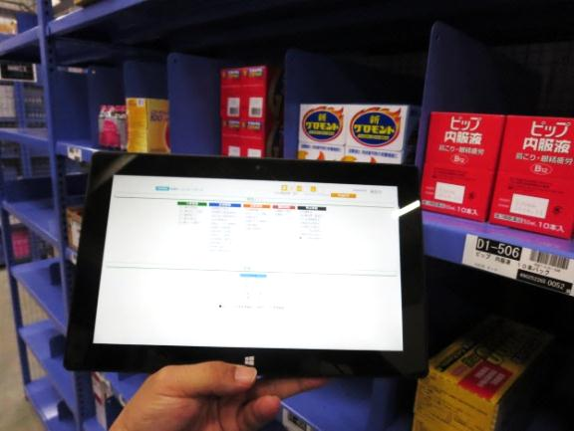
2.5. Distribution Center (Inventory & Shipment)
・Order picking from inventory according to P/O from stores.
・At MK Osaka Center, multi-tiers picking carts were introduced in addiction to single picking
by HHT(Hand Held Terminal).
・Inventory management aims to reduce inventory costs and transportation expenses,
meanwhile improve services by preventing delivery delay and stock out.

Slide 16
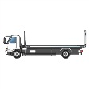
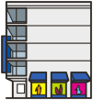
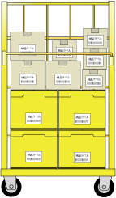


2.6. Transfer Center ( TypeⅠ& Type Ⅱ）
・ Transfer Center does not keep stocks. All goods received are sorted and shipped during the day.
Sorting/delivery methods are classified as below.
①TC- TypeⅠ
（Sorted for Stores）
②TC- TypeⅡ
（Total Volume Delivery）
・Goods sorted for stores are delivered to MK Center,
then consolidated with other goods at MK Center
and delivered to each store.
・Total amount of goods are delivered to MK Center.
Then good are sorted by categories and stores,
consolidated with other goods at MK Center and
delivered to each store.
Vendors
Vendors
Transfer Center
Transfer Center
Sorted for Stores
Stores
Stores

Slide 17
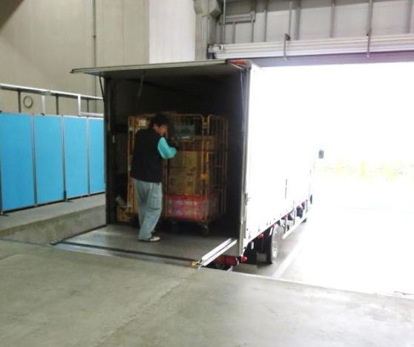
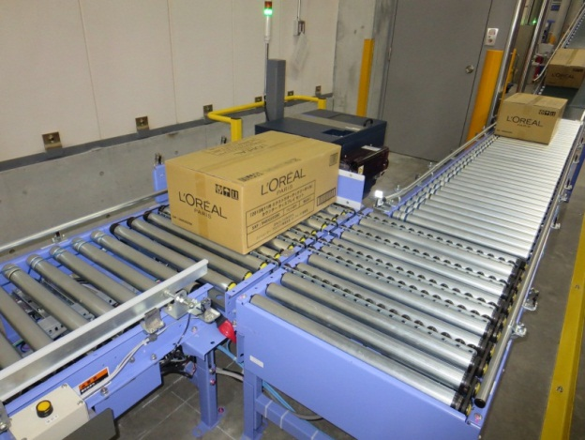
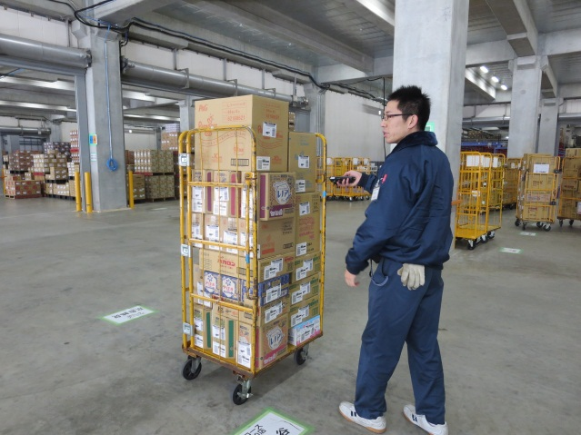
2.7．Transfer Center (Receiving Goods)
・ Arrival of goods from vendors or other centers are inspected with ASN(Advanced shipping
Notice).
・ Two types of delivery from vendors: sorted for stores or total volume.
・ Inspections are made by sorters in addiction to HHTs(Hand Held Terminal).

Slide 18
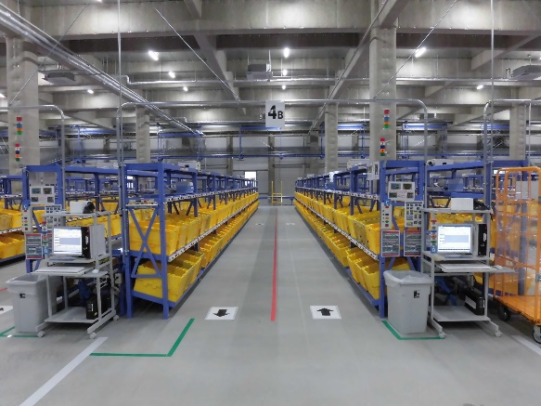
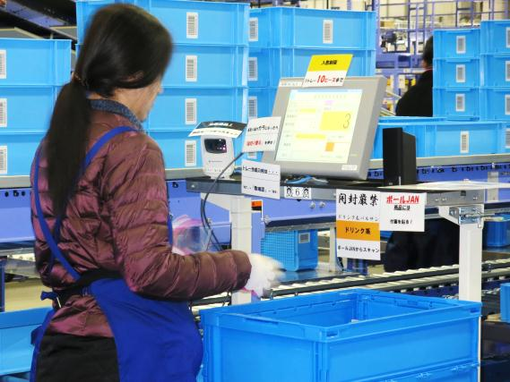
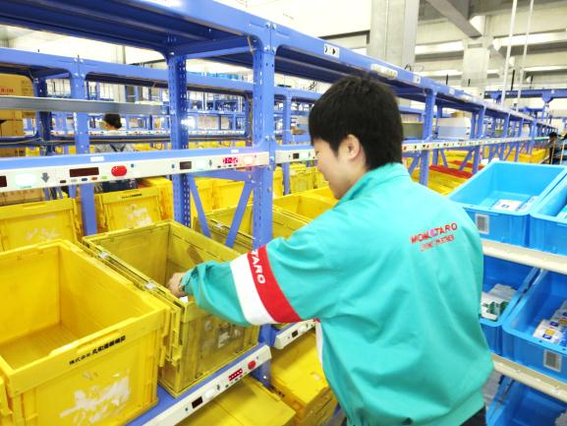
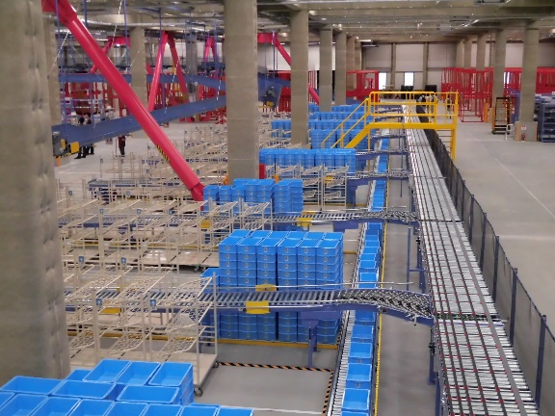
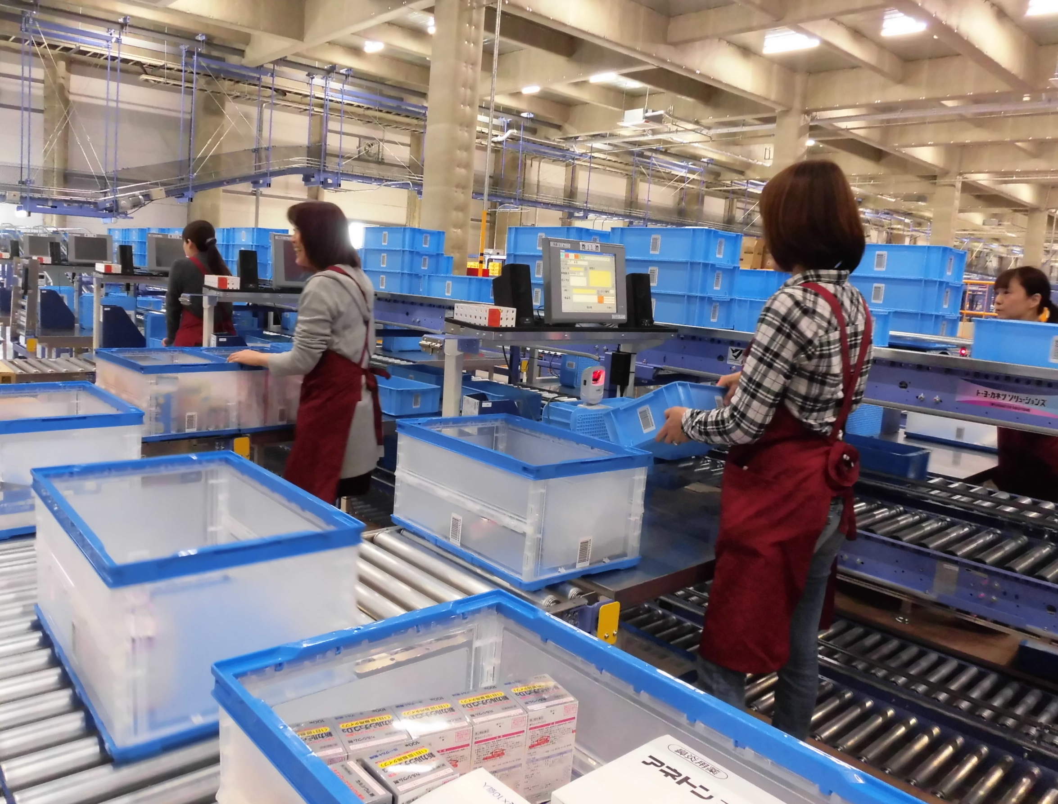
2.8. Transfer Center (Total Volume Sorting)
・Both DC and TC goods are sorted into folding containers according to
categories by using DAS(Digital Assort System).
＊DAS(Digital Assort System) : computer assisted system that assort goods into folding containers
classified by categories and stores following the digital indicators and color lamps.

Slide 19
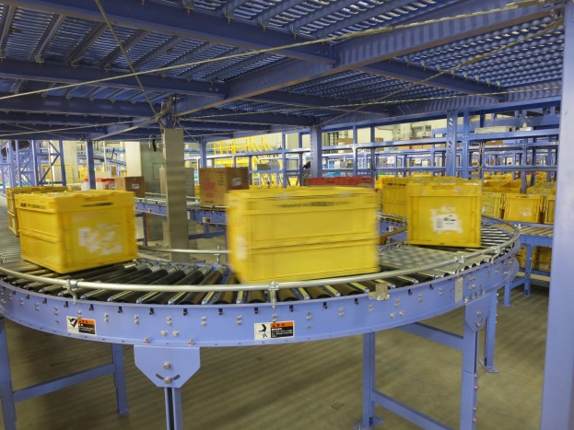




2.9. Shipment
・After picking and assorting, all boxes are loaded into Roll Box Pallets by stores.
・Scan all boxes in Roll Box Pallets by HHT to prevent shipping errors.

Slide 20

2.10. Reversal Logistics (Total Volume Returns)
・ Returned goods are collected from stores to MK Osaka Centers.
・ Returns are sorted and sent back by vendors/makers.
・ Total Volume Returns have reduced burden of both stores and vendors.

Slide 21






2.11. Omni-Channel (EC)
・ MK Osaka Center started EC shipment from Feb 15, 2017 as the hub of Omni-Channel
in western Japan.
・ Goods are shipped to customers(private users) who place orders to MK online stores.
・ Medical supplies can be shipped at MK real store on the first floor.
・ Over-the-counter receipt can be made at MK real stores for customers who placed order online.
Matsumotokiyoshi Online Store
MK Osaka Center (EC)
Inventory Securing
Order Data
ご注文者様（個人のお客様）
Customers
MK Osaka Center
個人宅へ配送
Delivery to Customer’s House
or
店頭受け取り
Customer receives goods at MK stores.
Picking/Inspecting/Packing
for Each Customer.

